Slide 1
Chapter 7– Cell Transport
Passive
Active
Tonic
Cell membrane
H-2-Oh Yea
$100
$100
$100
$100
$100
$200
$200
$200
$200
$200
$300
$300
$300
$300
$300
$400
$400
$400
$400
$400
$500
$500
$500
$500
$500
FINAL ROUND

Slide 2
Passive: $100 Question
The movement of solute from high to low concentration
ANSWER
BACK TO GAME

Slide 3
Passive: $100 Answer
What is diffusion?
BACK TO GAME

Slide 4
Cycle: $200 Question
The movement of water from high to low concentration
ANSWER
BACK TO GAME

Slide 5
Passive : $200 Answer
What is osmosis?
BACK TO GAME

Slide 6
Passive : $300 Question
Transport that can go right through the cellular membrane.
ANSWER
BACK TO GAME

Slide 7
Passive : $300 Answer
What is diffusion?
BACK TO GAME

Slide 8
Passive : $400 Question
The cell membrane only lets small, nonpolar things through.
ANSWER
BACK TO GAME

Slide 9
Passive : $400 Answer
What is selectively permeable?
BACK TO GAME

Slide 10
Passive : $500 Question
Movement of something from high to low concentration through a cell membrane protein.
ANSWER
BACK TO GAME

Slide 11
Passive : $500 Answer
What is facilitated diffusion?
BACK TO GAME

Slide 12
Active $100 Question
This requires a protein pump and cellular Energy
ANSWER
BACK TO GAME

Slide 13
Active: $100 Answer
What is active transport?
BACK TO GAME

Slide 14
Active : $200 Question
The cells money. Needed for active transport
ANSWER
BACK TO GAME

Slide 15
Active: $200 Answer
What is ATP?
BACK TO GAME

Slide 16
Active : $300 Question
The macromolecule responsible for active transport in the cell membrane .
ANSWER
BACK TO GAME

Slide 17
Division : $300 Answer
What is a protein?
BACK TO GAME

Slide 18
Division : $400 Question
Bulk transport inside of the cell.
ANSWER
BACK TO GAME

Slide 19
Division: $400 Answer
What is endocytosis?
BACK TO GAME

Slide 20
Division: $500 Question
Daily Double!
How much would you like to wager?
ANSWER
BACK TO GAME

Slide 21
Active : $500 Answer
Which organelles are responsible exocytosis?
BACK TO GAME

Slide 22
What isRER, Golgi, Vesicles

Slide 23
Tonic: $100 Question
Solute or water will diffuse or undergo osmosis until this happens.
ANSWER
BACK TO GAME

Slide 24
Tonic: $100 Answer
What is equilibrium?
BACK TO GAME

Slide 25
Tonic : $200 Question
A cell is at equilibrium with its environment. The solution the cell is in must be this.
ANSWER
BACK TO GAME

Slide 26
Tonic : $200 Answer
What is isotonic?
BACK TO GAME

Slide 27
Tonic : $300 Question
A cell grows in this solution.
ANSWER
BACK TO GAME

Slide 28
Tonic : $300 Answer
What is hyoptonic?
BACK TO GAME

Slide 29
Tonic : $400 Question
A cell appears shriveled and shrunk in this solution.
ANSWER
BACK TO GAME

Slide 30
Tonic : $400 Answer
What is hypertonic?
BACK TO GAME

Slide 31
Tonic! 500
The interaction between water molecules that is responsible for nearly every special property of water
ANSWER
BACK TO GAME

Slide 32
Tonic! 500
What is hydrogen bonding?
BACK TO GAME

Slide 33
Cell membrane: $100 Question
The cell membrane is mostly made of these
ANSWER
BACK TO GAME

Slide 34
The cell membrane: $100 Answer
What are phospolipids?
BACK TO GAME

Slide 35
The cell membrane : $200 Question
The hydrophobic part of the cell membrane are these.
ANSWER
BACK TO GAME

Slide 36
The cell membrane : $200 Answer
What are lipids?
BACK TO GAME

Slide 37
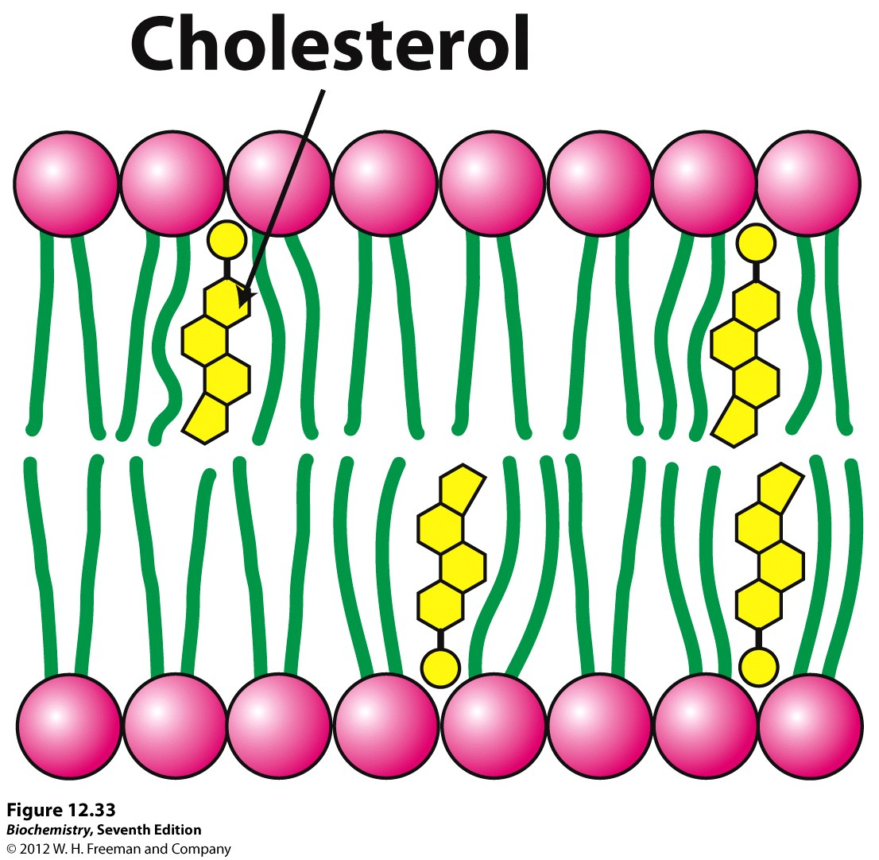
The cell membrane : $300 Question
This 4 carbon ring structure that causes cell membranes to be more fluid at cold temperatures
ANSWER
BACK TO GAME

Slide 38
The cell membrane : $300 Answer
What is cholesterol?
BACK TO GAME

Slide 39
The cell membrane : $400 Question
Allows for transport of large or polar things through the cell membrane
ANSWER
BACK TO GAME

Slide 40
The cell membrane : $400 Answer
What are membrane proteins?
BACK TO GAME

Slide 41
The cell membrane : $500 Question
The 4 classes of lipids.
ANSWER
BACK TO GAME

Slide 42
Neurotransmitters and Integration: $500 Answer
What are phospholipids, triglycerides, steroids, and waxes?
BACK TO GAME

Slide 43
Mixed Bag: $100 Question
The attraction of water to other water molecules
ANSWER
BACK TO GAME

Slide 44
Mixed Bag: $100 Answer
What is cohesion?
BACK TO GAME

Slide 45
Mixed Bag: $200 Question
Lipids hate water, so they are said to be this_____________. Where as ions and polar things love water, so that are said to be this___________.
ANSWER
BACK TO GAME

Slide 46
Mixed Bag: $200 Answer
What is hydrophobic and hydrophilic
BACK TO GAME

Slide 47
Mixed Bag: $300 Question
Plants and animals are both these
ANSWER
BACK TO GAME

Slide 48
Mixed Bag: $300 Answer
What are eukaryotes?
BACK TO GAME

Slide 49
Mixed Bag: $400 Question
At .1Molarity, the solution must have been this
ANSWER
BACK TO GAME

Slide 50
Mixed Bag: $400 Answer
What is hypotonic?
BACK TO GAME

Slide 51
Mixed Bag: $500 Question
The essential items in a scientific experiment
ANSWER
BACK TO GAME

Slide 52
Mixed Bag: $500 Answer
What is an IV, DV, control group, a whole lot of constants, data, repeatable procedures and more!?
BACK TO GAME

Slide 53
FINAL ROUND Question
Describe equilibrium
ANSWER
BACK TO GAME

